Slide 1
Policypal - Policy & Claims Copilot
AI-powered Policy Assistance

Slide 2
Problem Statement
Customers struggle to interpret complex insurance policies.
Manual support is slow, inconsistent, and costly.
Claims teams spend time on repetitive, rule-based checks.
Business needs instant, accurate, contextual answers.

Slide 3
Solution Overview
PolicyPal Chatbot built with Retrieval-Augmented Generation (RAG) + LLM.
Provides natural language Q&A on policy documents.
Applies pre-check validation rules for quick response.
Integrates with existing policy PDFs and scales to multiple policies.

Slide 4
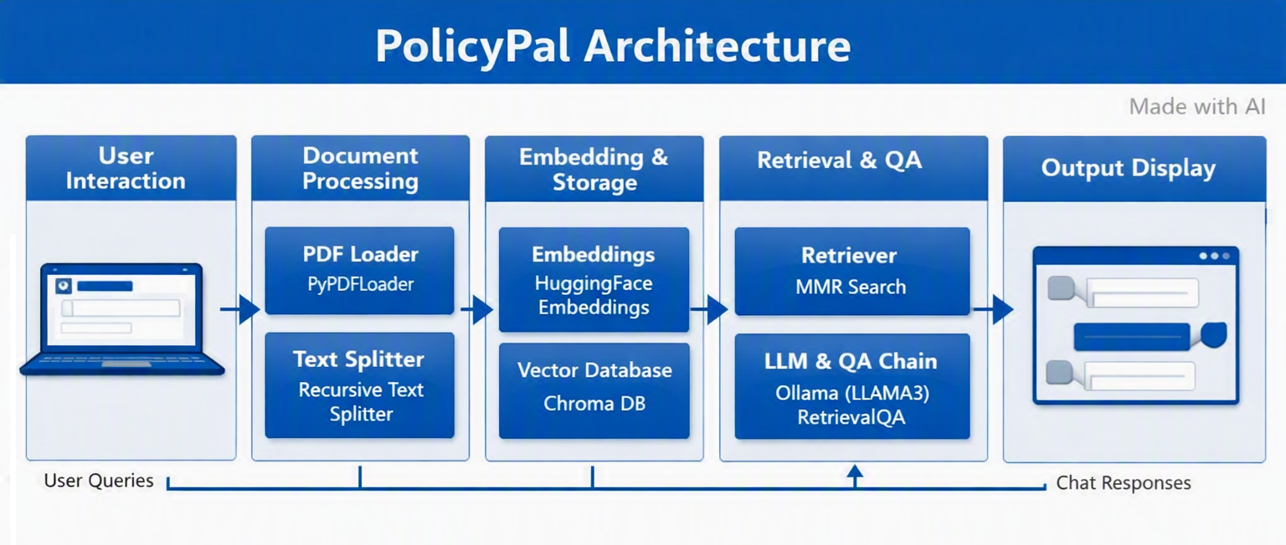
System Architecture

Slide 5
Key Features
📄 Policy document parsing (PDF ingestion)
🔍 Semantic search with embedding's
Vector store (Chroma) for fast similarity retrieval.
LLM-powered contextual Q&A
✅ Pre-check validation rules

Slide 6
Demo Flow
User enters query: “How to raise a claim?”
Retriever fetches relevant policy chunks.
LLM generates contextual answer
Pre-check rules applied (e.g., waiting period, limits).
Response displayed in Streamlit chat UI

Slide 7
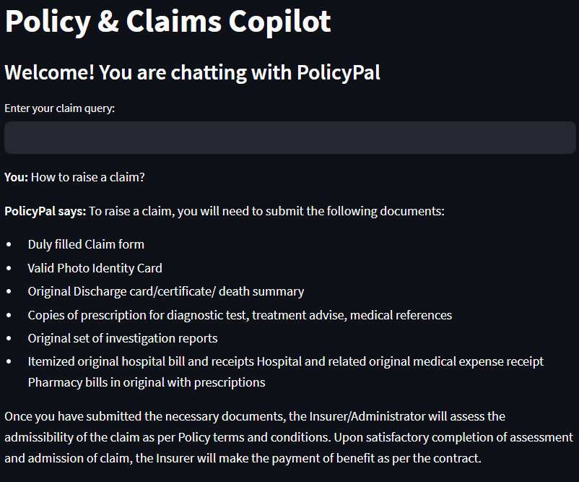
Sample Chat
PolicyPal Demo - Streamlit

Slide 8
Future Scope
Chat history retention (conversation memory & context).
Multi-policy support (aggregate across multiple documents).
Multilingual query handling for broader customer base.

Slide 9
PolicyPal = AI-powered assistant for insurance claims
Bridging complex policy language with customer clarity
Thank You…

